Slide 1
Class 6

Slide 2
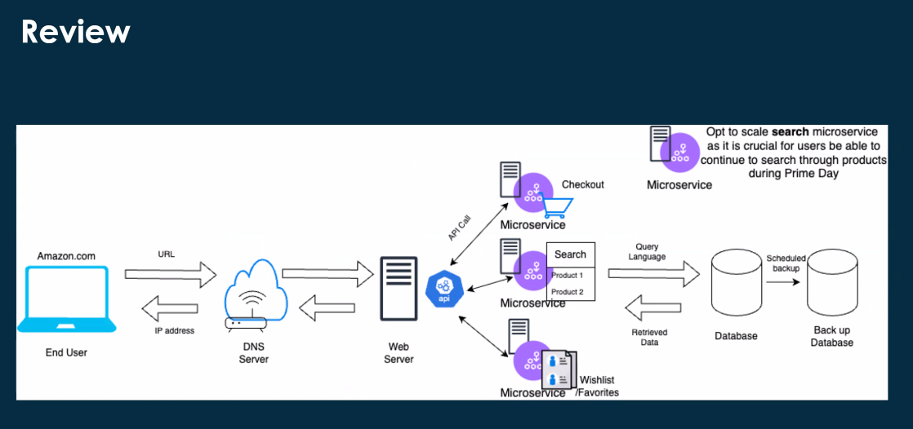

Slide 3
Review
What’s a good Uber driver?
What makes them high performing?
KPIs. KPI vs Metric. Metric are broad data points. KPI are specific points linked to performance.
What happens if a driver takes too long to pick you up?
SLA is more on a driver side.

Slide 4
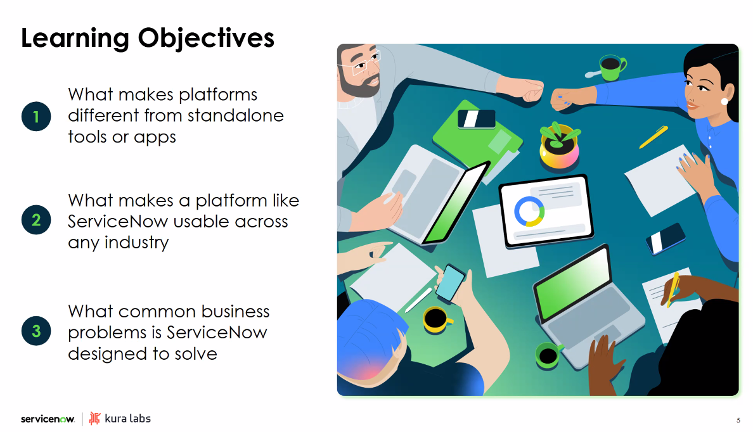
Learning Objectives

Slide 5
What is Cloud Computing?
Accessing a portion of services from Amazon itself (accessing their servers for example).

Slide 6
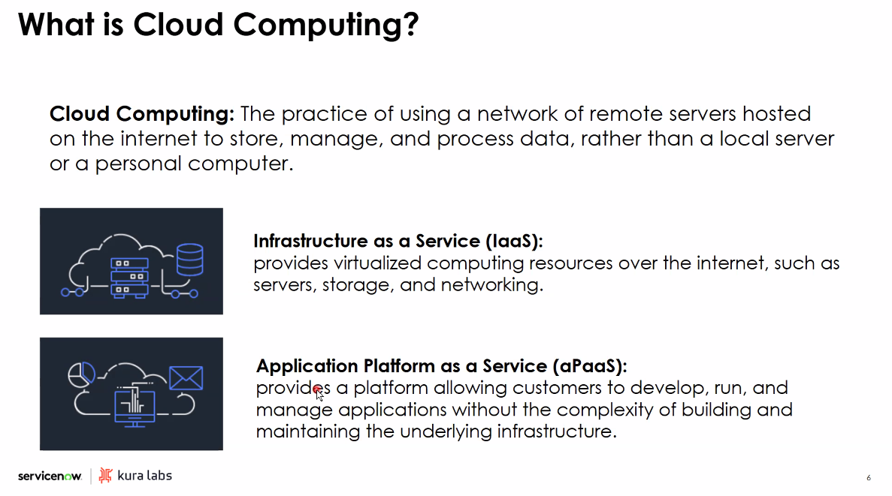

Slide 7
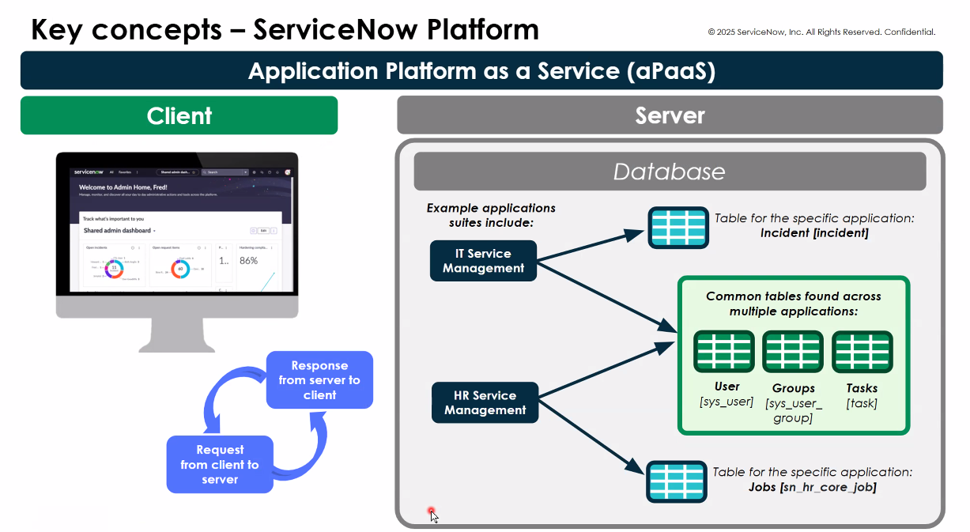

Slide 8
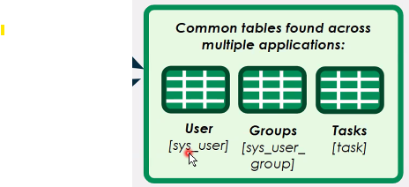

Slide 9
Schema – relational database, visual representation of the database, which data from which database connects to what other data. How is data organized.
Index of the table.

Slide 10
Horizontal vs vertical scaling.

Slide 11
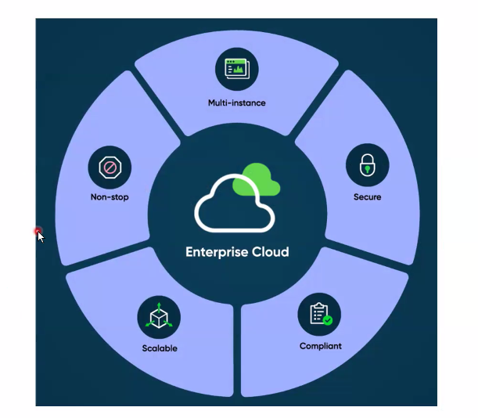

Slide 12
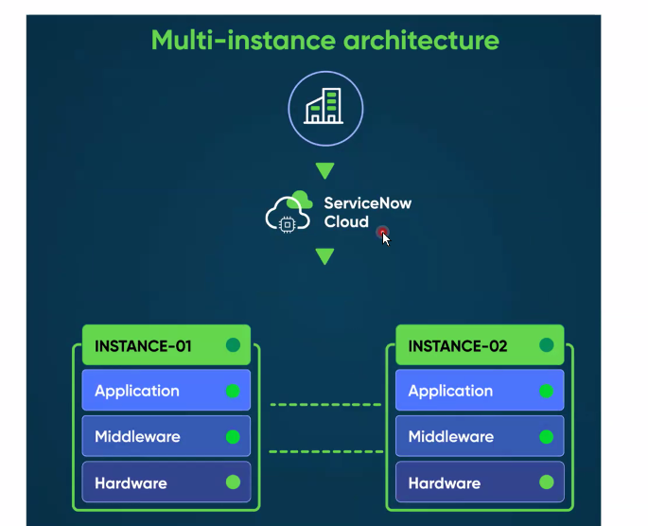
Each instance for each company
If you were to make a mistake in dev, it won’t go to prod.
Malware.
Fit-for-purpose.
Private data. SLA.
API calls, session created, tunnel, ports, authentication.

Slide 13
Failover – automatic, another instance of the database. Backup.

Slide 14
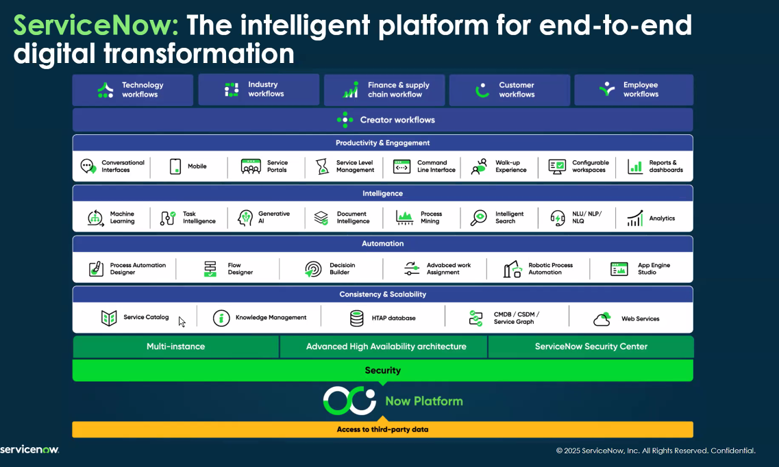

Slide 15
Baseline implementation – what comes preloaded on that instance.

Slide 16
Who Uses ServiceNow?
Healthcare
Banks
Aviation
Retail
Similar processes
Customization
Different level of access
Roles (roles, group, users in a group) – responsibilities
Manual process vs automation. All automatic processes were once manual.

Slide 17
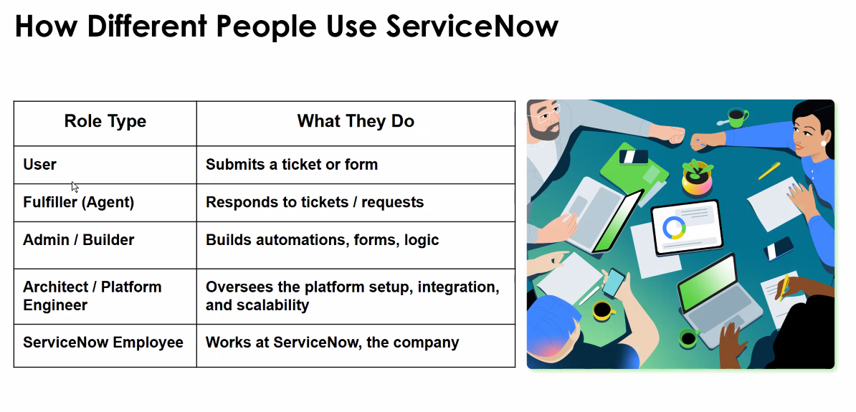

Slide 18
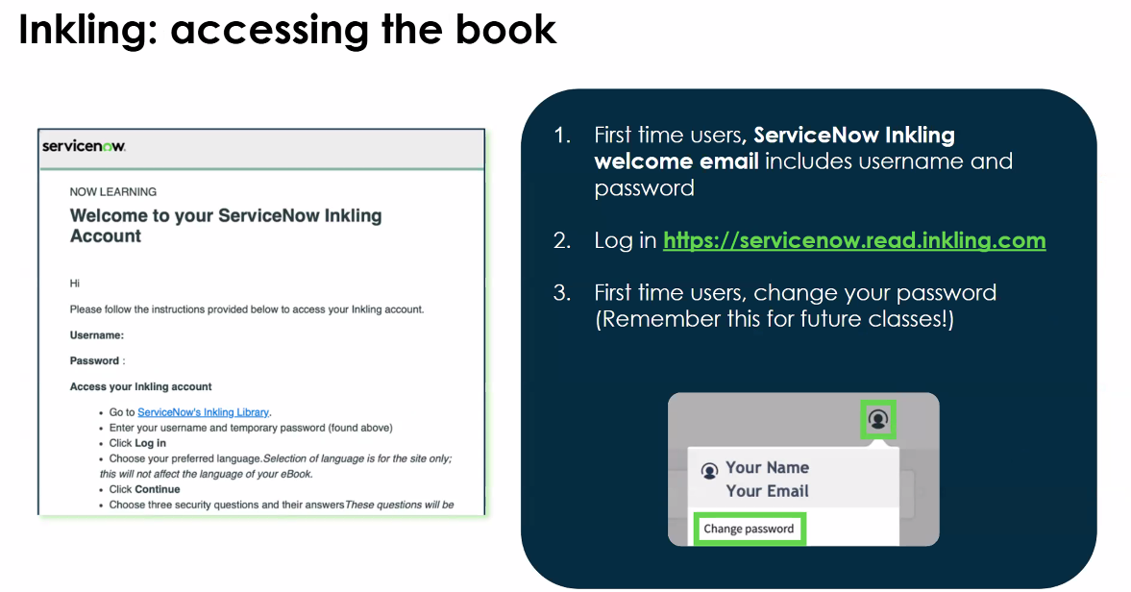

Slide 19
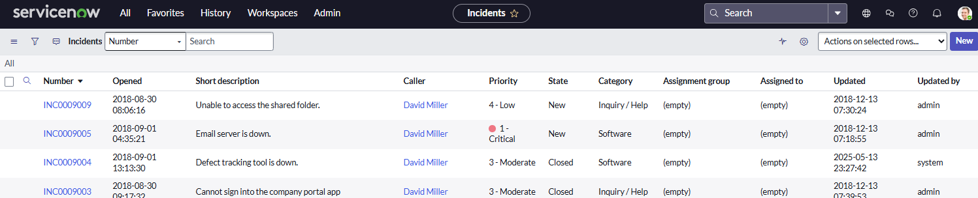
Navigation
Application are the main dropdown
Modules are under applications
Application -> Module ->Area of application -> Individual records
We are in All Module Incident Application

